Slide 1

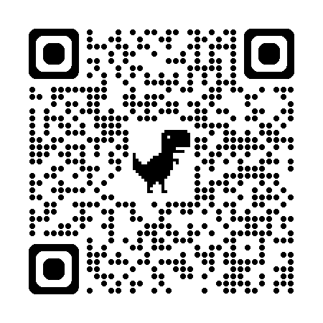

自然語言處理與應用 Natural Language Processing and Applications
Decoding Strategies
Instructor: 林英嘉 (Ying-Jia Lin)
2025/04/14
Course GitHub
Slido # NLP_0414

Slide 2
Outline
Hugging Face Tutorial with BERT [60 min]
Homework 3 [50 min]
Decoding Strategies [30 min]
Quiz [10 min]

Slide 3
Introduction to Hugging Face
An open-source library for state-of-the-art AI models (Natural Language Processing / Computer Vision / Audio ... ) with various deep learning frameworks (PyTorch / TensorFlow / JAX ...)
Links
Documentation: https://huggingface.co/docs
Source code: https://github.com/huggingface
Hugging Face Tutorial

Slide 4
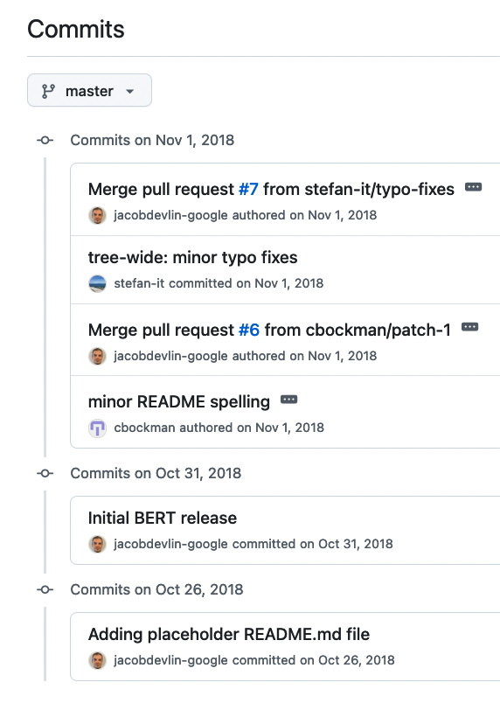
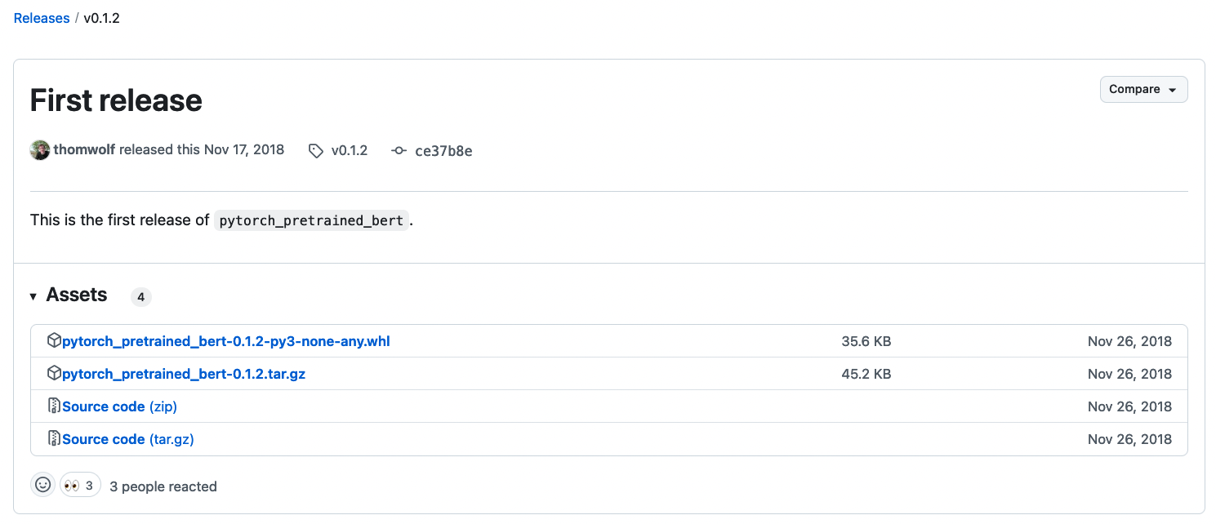
Hugging Face made the first PyTorch Implementation of BERT
https://github.com/huggingface/transformers/releases/tag/v0.1.2
https://github.com/google-research/bert/commits
Hugging Face Tutorial

Slide 5
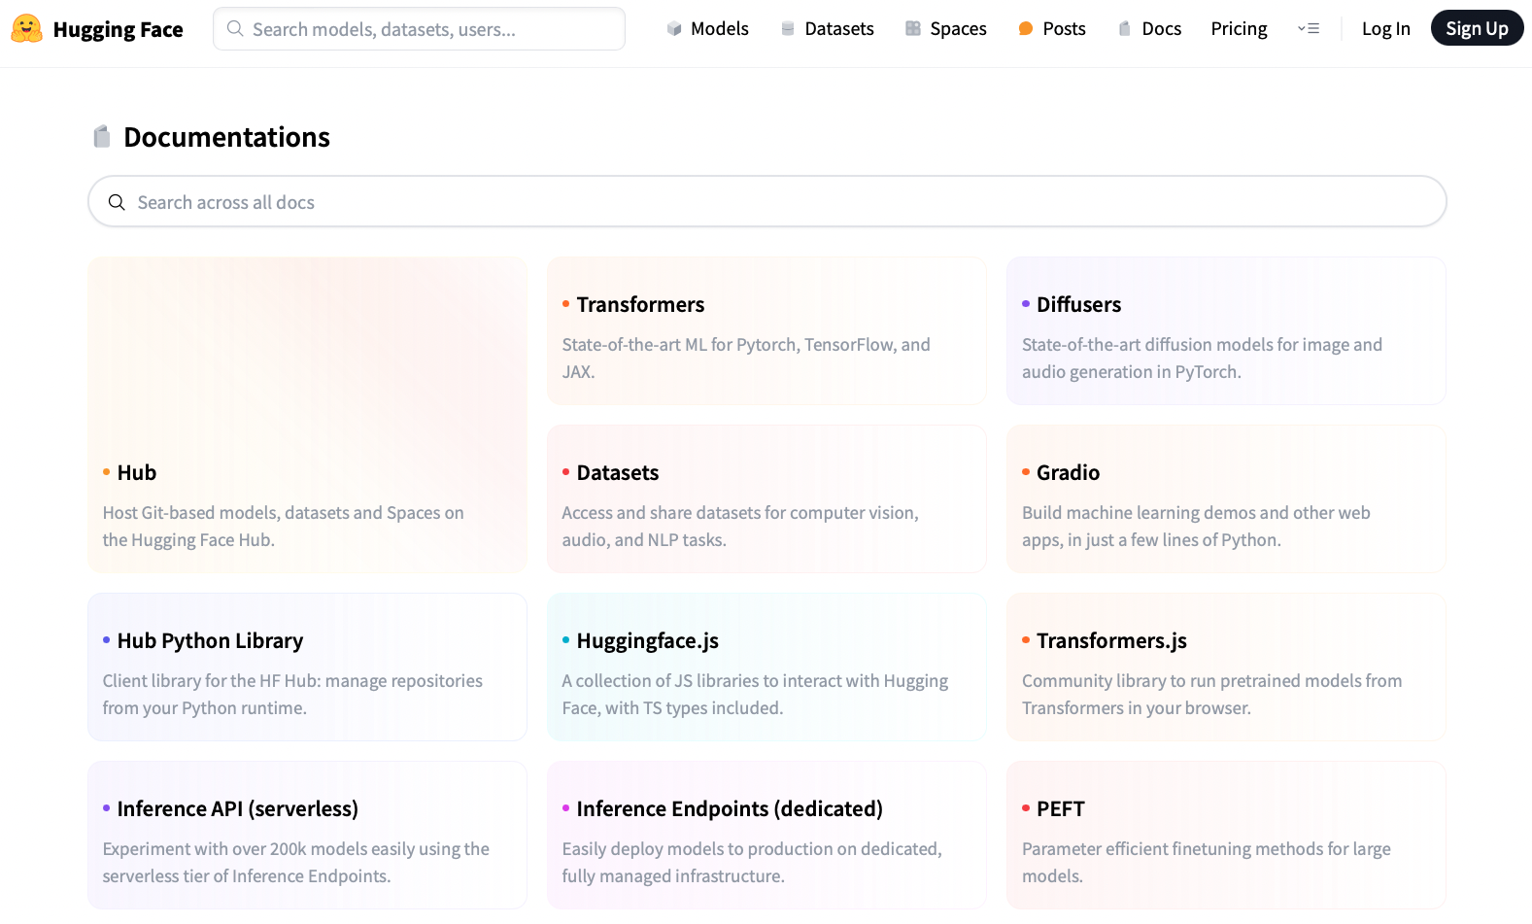
https://huggingface.co/docs
Hugging Face Tutorial

Slide 6
Installation
Basically, you need to install PyTorch first before you install transformers.
(Recommended)
pip install transformers
(If you want to try new things)
git clone https://github.com/huggingface/transformers.git
cd transformers
pip install -e .
Hugging Face Tutorial

Slide 7
Packages required in this tutorial
We need the following packages for this tutorial. On Colab, you may not need to re-install these packages for they may have already been installed.
!pip install torch==2.4.0
!pip install transformers==4.37.0
!pip install datasets==3.0.1
!pip install accelerate==0.21.0
!pip install scikit-learn==1.5.2
!pip install wget
!pip install tarfile
Hugging Face Tutorial

Slide 8
https://huggingface.co/docs
Hugging Face Tutorial

Slide 9
Check the versions of your packages
import torch
print(f"PyTorch version: {torch.__version__}")
import transformers
print(f"Hugging Face Transformers version: {transformers.__version__}")
import datasets
print(f"Hugging Face Datasets version: {datasets.__version__}")
Hugging Face Tutorial

Slide 10
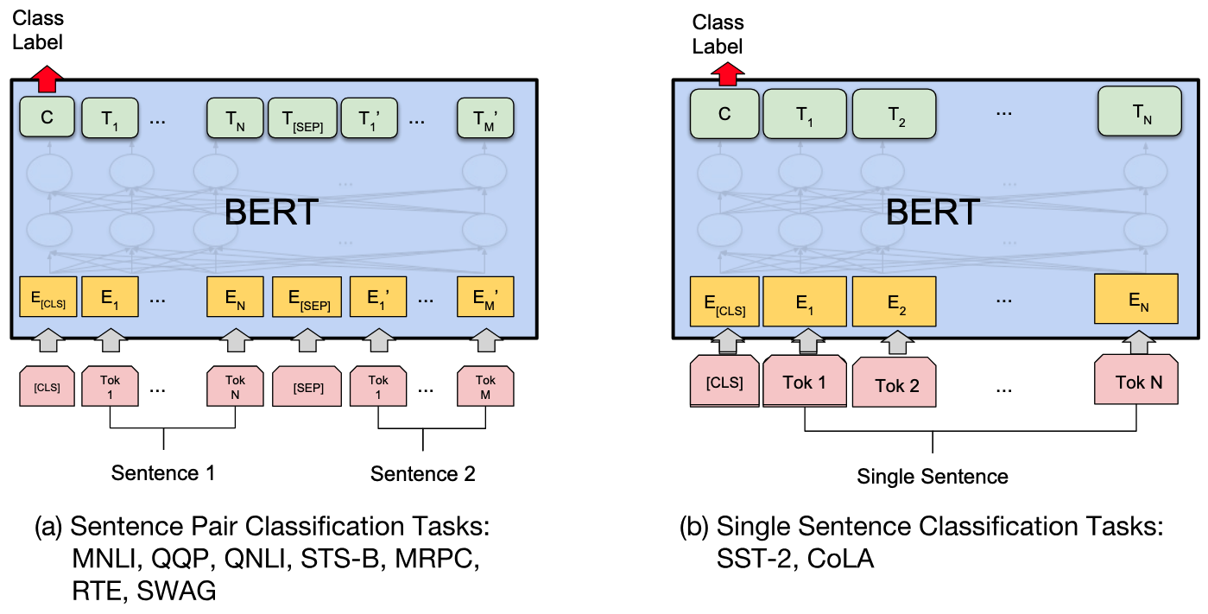
Sentence Classification with BERT
Devlin et al. "BERT: Pre-training of Deep Bidirectional Transformers for Language Understanding." NAACL 2019.
Hugging Face Tutorial

Slide 11
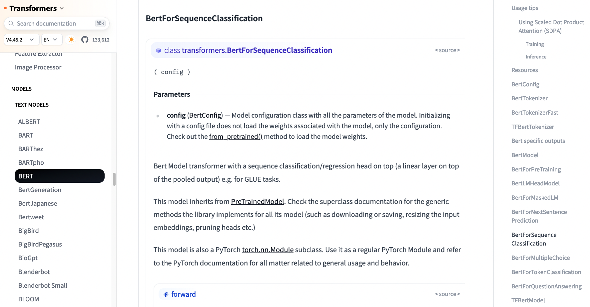
https://huggingface.co/docs/transformers/model_doc/bert#transformers.BertForSequenceClassification
Hugging Face Tutorial

Slide 12
Workflow for training a model using Hugging Face
Get the dataset
Model Training
Model Evaluations
Option1: Download the raw data
Option2: Get the dataset from Hugging Face Datasets (You may not need to perform data pre-processing.)
Option1: Use native PyTorch
Option2: Use Hugging Face Trainer
Option1: Use native PyTorch
Option2: Use Hugging Face Trainer
Hugging Face Tutorial

Slide 13
Dataset Preparation (IMDb reviews)
import wget
import tarfile
# Download the IMDb dataset
url = 'http://ai.stanford.edu/~amaas/data/sentiment/aclImdb_v1.tar.gz'
filename = wget.download(url, out='./’)
# Unzip the `aclImdb_v1.tar.gz` file
tar = tarfile.open('aclImdb_v1.tar.gz', 'r:gz')
tar.extractall()
Hugging Face Tutorial

Slide 14
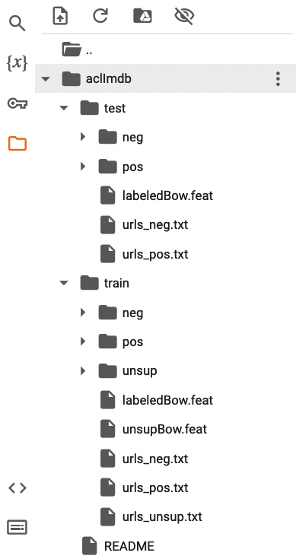
The folder structure of IMDb after unzipping
Sentiment Analysis
pos
Positive movie reviews
neg
Negative movie reviews
Hugging Face Tutorial

Slide 15
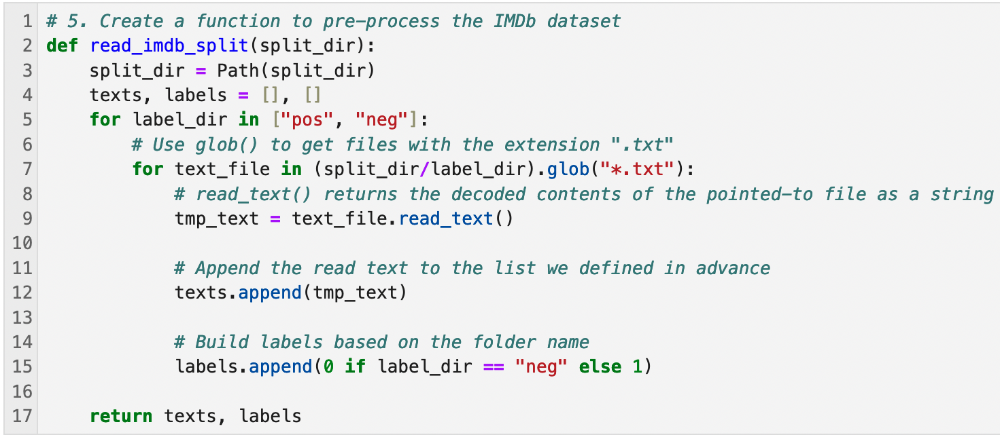
Create a function to pre-process the IMDb dataset
[Doc of Pathlib] https://docs.python.org/3/library/pathlib.html#pathlib.Path.read_text
Hugging Face Tutorial

Slide 16
Pre-process the IMDb dataset
# 6. Pre-process the IMDb dataset (run the cell)
train_texts, train_labels = read_imdb_split('aclImdb/train')
test_texts, test_labels = read_imdb_split('aclImdb/test')
Hugging Face Tutorial

Slide 17
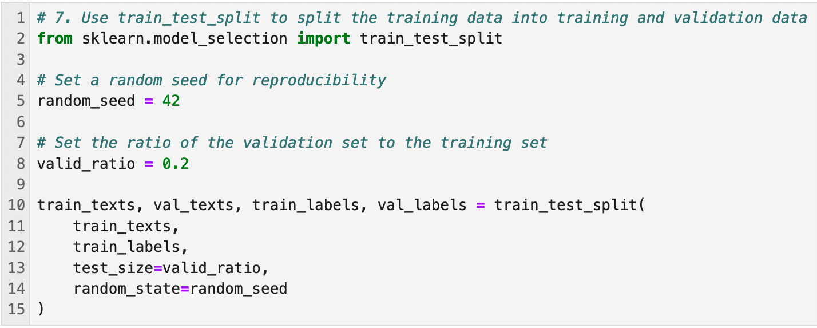
Dataset splitting
Hugging Face Tutorial

Slide 18
Pre-process the input sentences for BERT
Devlin et al. "BERT: Pre-training of Deep Bidirectional Transformers for Language Understanding." NAACL 2019.
Hugging Face Tutorial

Slide 19
Hugging Face Tokenizer
# Load the Hugging Face tokenizer
model_name = "bert-base-uncased"
# Use .from_pretrained() for a pre-trained model
tokenizer = transformers.AutoTokenizer.from_pretrained(model_name)
uncased: it does not make a difference between english and English.
https://huggingface.co/google-bert/bert-base-uncased
https://huggingface.co/google-bert/bert-base-cased
Hugging Face Tutorial

Slide 20
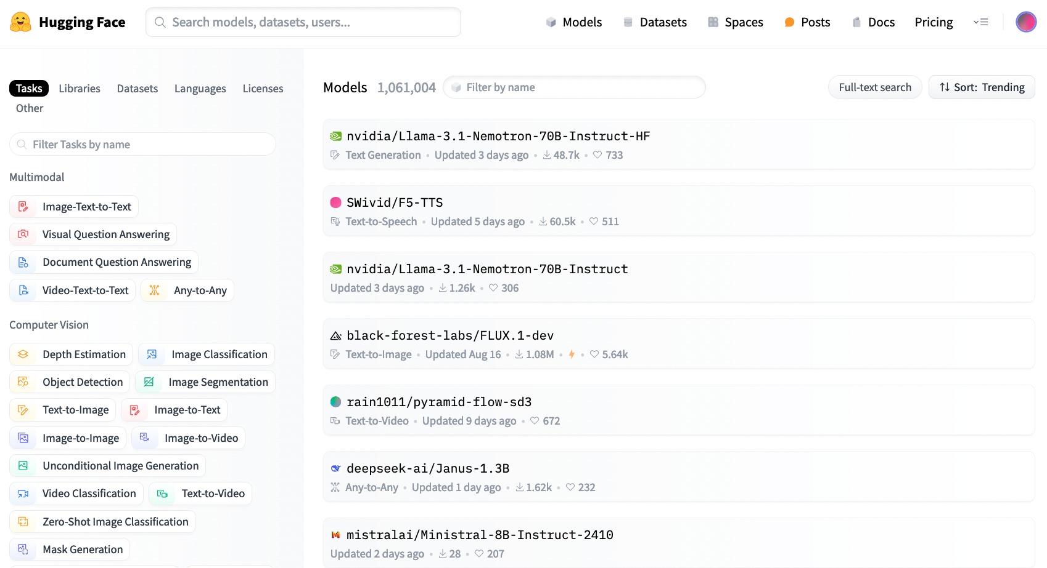
https://huggingface.co/models
Hugging Face Tutorial

Slide 21
Auto Classes (models, tokenizers)
BertTokenizer. GPT2Tokenizer
In many cases, the architecture you want to use can be guessed from the name or the path of the pretrained model you are supplying to the from_pretrained method.
AutoClasses are here to do this job for you so that you automatically retrieve the relevant model given the name/path to the pretrained weights/config/vocabulary:
Ex: model = AutoModel.from_pretrained('bert-base-cased') will create an instance of BertModel).
https://huggingface.co/transformers/v3.0.2/model_doc/auto.html
Hugging Face Tutorial

Slide 22
Outputs of the Tokenizer (Case1)
Case 1: 沒指定 max_length
# 8. Load the Hugging Face tokenizer
train_encodings = tokenizer(train_texts, truncation=True, padding=True)
val_encodings = tokenizer(val_texts, truncation=True, padding=True)
test_encodings = tokenizer(test_texts, truncation=True, padding=True)
 | Type 1: 參數填布林值 (boolean) | Type 2: 參數填字串 (String)
truncation | Do truncation: True No truncation: False | Do truncation: longest_first / only_second / only_first No truncation: do_not_truncate
padding | Do padding: True No padding: False | Do padding: longest / max_length / No padding: do_not_pad

Slide 23
Outputs of the Tokenizer (Case2)
Case 2: 指定 max_length
encodings = tokenizer(
texts,
truncation=True,
padding=True,
max_length=300
) # Do truncation and padding to a length of 300 tokens
 | Type 1: 參數填布林值 (boolean) | Type 2: 參數填字串 (String)
truncation | Do truncation: True No truncation: False | Do truncation: longest_first / only_second / only_first No truncation: do_not_truncate
padding | Do padding: True No padding: False | Do padding: longest / max_length / No padding: do_not_pad
max_length:
None (沒指定) -> 預設 model_max_length
int -> Your desired maximum length.

Slide 24
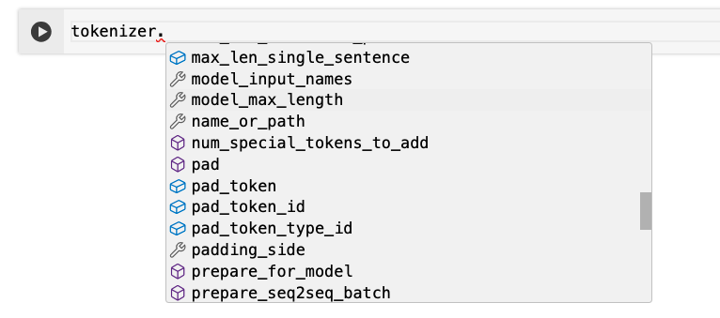
Methods inside `tokenizer`
Type the dot and wait for a few seconds (on Colab)
Or you can use `dir` to check all the methods of the object
tokenizer_methods = dir(tokenizer)
# Group them into rows for better readability
for i in range(0, len(tokenizer_methods), 5):
print(", ".join(tokenizer_methods[i:i+5]))
Hugging Face Tutorial

Slide 25
Some useful methods of `tokenizer`
Example using "bert-base-uncased"
(From this slide, the output will be highlighted in blue.)
# Get the maximum length of the pre-trained model
print(tokenizer.model_max_length)
512
# Get the ID of the special tokens
print(tokenizer.vocab["[CLS]"])
print(tokenizer.vocab["[SEP]"])
print(tokenizer.vocab["[PAD]"])
101
102
0
Hugging Face Tutorial

Slide 26
Check the tokenized results
The output of `tokenizer` is a dictionary wrapper.
# 查看 output encodings 的 key 值內容
print(val_encodings.keys())
dict_keys(['input_ids', 'token_type_ids', 'attention_mask'])
# 查看 output encodings 是什麼型態
print(type(val_encodings))
transformers.tokenization_utils_base.BatchEncoding
https://huggingface.co/transformers/v3.5.1/_modules/transformers/tokenization_utils_base.html
Hugging Face Tutorial

Slide 27
Check the tokenized results (input_ids)
Check the first data of the validation set.
print(val_encodings.input_ids[0])
[CLS]
[101, 1045, 2442, 6449, 1010, 1045, 2001, 2028, 1997, 1996, 15315, 23606, 6558, 2040, 28179, 13224, 2023, 2265, 2077, 4659, 2151, 2592, 2001, 4487, 11393, 26972, 2055, 2009, 1012, 1045, 4340, 2008, 2009, 2001, 2183, 2000, 2022, 1037, 10036, 6714, 1011, 2125, 8546, 2011, 8923, 1040, 1012, 5405, 26974, 1996, 2128, 13535, 2239, 1011, 23967, 1012, 1026, 7987, 1013, 1028, 1026, 7987, 1013, 1028, 1045, 2001, 3308, 999, 1026, 7987, 1013, 1028, 1026, 7987, 1013, 1028, 1996, 4405, 3727, 2019, 6581, 8605, 2588, 1996, 7193, 1012, 1996, 23661, 2003, 28851, 999, 1997, 2607, 1010, 28223, 18667, 2290, 8244, 2097, 2424, 3209, 26275, 1999, 1996, 5436, 1010, 2029, 2003, 4208, 2006, 1996, 2458, 1997, 1996, 22330, 7811, 2015, 2077, 1996, 2034, 2162, 1012, 1006, 5388, 2086, 2077, 1996, 2824, 1997, 1996, 18667, 2290, 4405, 1007, 1012, 1996, 4405, 2036, 4473, 2005, 24159, 1010, 4415, 10886, 2049, 5436, 1998, 4784, 1999, 1996, 2034, 2112, 1997, 1996, 2792, 1012, 1026, 7987, 1013, 1028, 1026, 7987, 1013, 1028, 2123, 1005, 1056, 2022, 13534, 1024, 1000, 6178, 14735, 1000, 2003, 2025, 18667, 2290, 1012, 2057, 2024, 3591, 2007, 2019, 10047, 16862, 3512, 1010, 18439, 3689, 20384, 2011, 26422, 1010, 15236, 1010, 1998, 6801, 4784, 1012, 1026, 7987, 1013, 1028, 1026, 7987, 1013, 1028, 1996, 9179, 9319, 18667, 2290, 1005, 1055, 4781, 1025, 2358, 27914, 2480, 1998, 17103, 2024, 3432, 2004, 24826, 15683, 1012, 17103, 1005, 13954, 1997, 3312, 4205, 2050, 1010, 4427, 2011, 19330, 15530, 1005, 13954, 1997, 2520, 1010, 3957, 1037, 6919, 12185, 1997, 2520, 1005, 1055, 14779, 2269, 1012, 2358, 27914, 2480, 1005, 1055, 13954, 1997, 2852, 1012, 3897, 9221, 27895, 2015, 1037, 2843, 1997, 3241, 1998, 3980, 1012, 1026, 7987, 1013, 1028, 1026, 7987, 1013, 1028, 2065, 1996, 3737, 1997, 1996, 4405, 2003, 2151, 12407, 1997, 2054, 1005, 1055, 2664, 2000, 2272, 1010, 16428, 2213, 1998, 1996, 5541, 2136, 2024, 2275, 2000, 3613, 18667, 2290, 1005, 1055, 8027, 1997, 2034, 1011, 3446, 2547, 4730, 2007, 2178, 3040, 7699, 2580, 2547, 17743, 1012, 102, 0, 0, 0, 0, 0, 0, 0, 0, 0, 0, 0, 0, 0, 0, 0, 0, 0, 0, 0, 0, 0, 0, 0, 0, 0, 0, 0, 0, 0, 0, 0, 0, 0, 0, 0, 0, 0, 0, 0, 0, 0, 0, 0, 0, 0, 0, 0, 0, 0, 0, 0, 0, 0, 0, 0, 0, 0, 0, 0, 0, 0, 0, 0, 0, 0, 0, 0, 0, 0, 0, 0, 0, 0, 0, 0, 0, 0, 0, 0, 0, 0, 0, 0, 0, 0, 0, 0, 0, 0, 0, 0, 0, 0, 0, 0, 0, 0, 0, 0, 0, 0, 0, 0, 0, 0, 0, 0, 0, 0, 0, 0, 0, 0, 0, 0, 0, 0, 0, 0, 0, 0, 0, 0, 0, 0, 0, 0, 0, 0, 0, 0, 0, 0, 0, 0, 0, 0, 0, 0, 0, 0, 0, 0, 0, 0, 0, 0, 0, 0, 0, 0, 0, 0, 0, 0, 0, 0, 0, 0, 0, 0, 0, 0, 0, 0, 0, 0, 0, 0, 0, 0, 0, 0, 0, 0, 0, 0, 0, 0, 0, 0]
[SEP]
[PAD]
Hugging Face Tutorial

Slide 28
Check the tokenized results (token_type_ids)
Check the first data of the validation set.
print(val_encodings.token_type_ids[0])
[0, 0, 0, 0, 0, 0, 0, 0, 0, 0, 0, 0, 0, 0, 0, 0, 0, 0, 0, 0, 0, 0, 0, 0, 0, 0, 0, 0, 0, 0, 0, 0, 0, 0, 0, 0, 0, 0, 0, 0, 0, 0, 0, 0, 0, 0, 0, 0, 0, 0, 0, 0, 0, 0, 0, 0, 0, 0, 0, 0, 0, 0, 0, 0, 0, 0, 0, 0, 0, 0, 0, 0, 0, 0, 0, 0, 0, 0, 0, 0, 0, 0, 0, 0, 0, 0, 0, 0, 0, 0, 0, 0, 0, 0, 0, 0, 0, 0, 0, 0, 0, 0, 0, 0, 0, 0, 0, 0, 0, 0, 0, 0, 0, 0, 0, 0, 0, 0, 0, 0, 0, 0, 0, 0, 0, 0, 0, 0, 0, 0, 0, 0, 0, 0, 0, 0, 0, 0, 0, 0, 0, 0, 0, 0, 0, 0, 0, 0, 0, 0, 0, 0, 0, 0, 0, 0, 0, 0, 0, 0, 0, 0, 0, 0, 0, 0, 0, 0, 0, 0, 0, 0, 0, 0, 0, 0, 0, 0, 0, 0, 0, 0, 0, 0, 0, 0, 0, 0, 0, 0, 0, 0, 0, 0, 0, 0, 0, 0, 0, 0, 0, 0, 0, 0, 0, 0, 0, 0, 0, 0, 0, 0, 0, 0, 0, 0, 0, 0, 0, 0, 0, 0, 0, 0, 0, 0, 0, 0, 0, 0, 0, 0, 0, 0, 0, 0, 0, 0, 0, 0, 0, 0, 0, 0, 0, 0, 0, 0, 0, 0, 0, 0, 0, 0, 0, 0, 0, 0, 0, 0, 0, 0, 0, 0, 0, 0, 0, 0, 0, 0, 0, 0, 0, 0, 0, 0, 0, 0, 0, 0, 0, 0, 0, 0, 0, 0, 0, 0, 0, 0, 0, 0, 0, 0, 0, 0, 0, 0, 0, 0, 0, 0, 0, 0, 0, 0, 0, 0, 0, 0, 0, 0, 0, 0, 0, 0, 0, 0, 0, 0, 0, 0, 0, 0, 0, 0, 0, 0, 0, 0, 0, 0, 0, 0, 0, 0, 0, 0, 0, 0, 0, 0, 0, 0, 0, 0, 0, 0, 0, 0, 0, 0, 0, 0, 0, 0, 0, 0, 0, 0, 0, 0, 0, 0, 0, 0, 0, 0, 0, 0, 0, 0, 0, 0, 0, 0, 0, 0, 0, 0, 0, 0, 0, 0, 0, 0, 0, 0, 0, 0, 0, 0, 0, 0, 0, 0, 0, 0, 0, 0, 0, 0, 0, 0, 0, 0, 0, 0, 0, 0, 0, 0, 0, 0, 0, 0, 0, 0, 0, 0, 0, 0, 0, 0, 0, 0, 0, 0, 0, 0, 0, 0, 0, 0, 0, 0, 0, 0, 0, 0, 0, 0, 0, 0, 0, 0, 0, 0, 0, 0, 0, 0, 0, 0, 0, 0, 0, 0, 0, 0, 0, 0, 0, 0, 0, 0, 0, 0, 0, 0, 0, 0, 0, 0, 0, 0, 0, 0, 0, 0, 0, 0, 0, 0, 0, 0, 0, 0, 0, 0, 0, 0, 0, 0, 0, 0, 0, 0, 0, 0, 0, 0, 0, 0, 0, 0, 0, 0, 0, 0, 0, 0]
All zeros show that this is a single-sentence task.
There will be additional ones for the token places of a second sentence.
Hugging Face Tutorial

Slide 29
Check the tokenized results (token_type_ids)
Check the first data of the validation set.
print(val_encodings.token_type_ids[0])
If paired-sentence task:
[0, 0, 0, 0, 0, 0, 0, 0, 0, 0, 0, 0, 0, 0, 0, 0, 0, 0, 0, 0, 0, 0, 0, 0, 0, 0, 0, 0, 0, 0, 0, 0, 0, 0, 0, 0, 0, 0, 0, 0, 0, 0, 0, 0, 0, 0, 0, 0, 0, 0, 0, 0, 0, 0, 0, 0, 0, 0, 0, 0, 0, 0, 0, 0, 0, 0, 0, 0, 0, 0, 0, 0, 0, 0, 0, 0, 0, 0, 0, 0, 0, 0, 0, 0, 0, 0, 0, 0, 0, 0, 0, 0, 0, 0, 0, 0, 0, 0, 0, 0, 0, 0, 0, 0, 0, 0, 0, 0, 0, 0, 0, 0, 0, 0, 0, 0, 0, 0, 0, 0, 0, 0, 0, 0, 0, 0, 0, 0, 0, 0, 0, 0, 0, 0, 0, 0, 0, 0, 0, 0, 0, 0, 0, 0, 0, 0, 0, 0, 0, 0, 0, 0, 0, 0, 0, 0, 0, 0, 0, 0, 0, 0, 0, 0, 0, 0, 0, 0, 0, 0, 0, 0, 0, 0, 0, 0, 0, 0, 0, 0, 0, 0, 0, 0, 0, 0, 0, 0, 0, 0, 0, 0, 0, 0, 0, 0, 0, 0, 0, 0, 0, 0, 0, 0, 0, 0, 0, 0, 0, 0, 0, 0, 0, 0, 0, 0, 0, 0, 0, 0, 0, 0, 0, 0, 0, 0, 0, 0, 0, 0, 0, 0, 0, 0, 0, 0, 0, 0, 0, 0, 0, 0, 0, 0, 0, 0, 0, 0, 0, 0, 0, 0, 0, 0, 0, 0, 0, 0, 0, 0, 0, 0, 0, 0, 0, 0, 0, 0, 0, 0, 0, 0, 0, 0, 0, 0, 0, 0, 0, 0, 0, 0, 0, 0, 0, 0, 0, 0, 0, 0, 0, 0, 0, 0, 0, 0, 0, 0, 0, 0, 0, 0, 0, 0, 0, 0, 0, 0, 0, 0, 0, 0, 0, 0, 0, 0, 0, 0, 0, 0, 0, 0, 0, 0, 0, 0, 0, 0, 0, 0, 0, 0, 0, 0, 0, 0, 0, 0, 0, 0, 0, 0, 0, 0, 0, 0, 0, 0, 0, 0, 0, 0, 0, 0, 0, 0, 0, 0, 0, 0, 0, 0, 0, 0, 0, 0, 0, 0, 0, 0, 0, 0, 0, 0, 0, 0, 0, 0, 0, 0, 0, 0, 0, 0, 0, 0, 0, 0, 0, 0, 0, 0, 0, 0, 0, 0, 0, 0, 0, 0, 0, 0, 0, 0, 0, 0, 0, 0, 0, 0, 0, 0, 0, 0, 0, 0, 0, 0, 0, 0, 0, 0, 0, 0, 0, 0, 0, 0, 0, 0, 0, 0, 0, 0, 0, 0, 0, 0, 0, 0, 0, 0, 0, 0, 0, 0, 0, 0, 0, 0, 0, 0, 0, 0, 0, 0, 0, 0, 0, 0, 0, 0, 0, 0, 0, 0, 0, 0, 0, 0, 0, 0, 0, 0, 0, 0, 0, 0, 0, 0, 0, 0, 0, 0, 0, 0, 0, 0, 0, 0, 0, 0, 0, 0, 0, 0, 0, 0, 0, 0, 0, 0, 0, 0, 0, 0, 0, 0, 0, 0, 0, 0, 1, 1, 1, 1, 1, 1, 1, 1, 1, 1, 1, 1, 1, 1, 1, 1, 1, 1, 1, 1, 1, 1, 1, 1, 1, 1, 1, 1, 1, 1, 1, 1, 1, 1, 1, 1, 1, 1, 1, 1, 1, 1, 1, 1, 1, 1, 1, 1, 1, 1, 1, 1, 1, 1, 1, 1, 1, 1, 1, 1, 1, 1, 1, 1, 1, 1, 1, 1, 1, 1, 1, 1, 1, 1, 1, 1, 1, 1, 1, 1, 1, 1, 1, 1, 1, 1, 1, 1, 1, 1, 1, 1, 1, 1, 1, 1, 1, 1, 1, 1, 1, 1, 1, 1, 1, 1, 1, 1, 1, 1, 1, 1, 1, 1, 1, 1, 1, 1, 1, 1, 1, 1, 1, 1, 1, 1, 1, 1, 1, 1, 1, 1, 1, 1, 1, 1, 1, 1, 1, 1, 1, 1, 1, 1, 1, 1, 1, 1, 1, 1, 1, 1, 1, 1, 1, 1, 1, 1, 1, 1, 1, 1, 1, 1, 1, 1, 1, 1, 1, 1, 1, 1, 1, 1, 1, 1, 1, 1, 1, 1, 1, 1, 1, 1, 1, 1, 1, 1, 1, 1, 1, 1, 1, 1, 1, 1, 1, 1, 1, 1, 1, 1, 1, 1, 1, 1, 1, 1]
0: 表示句子A, 1: 表示句子B
Hugging Face Tutorial

Slide 30
Check the tokenized results (attention_mask)
Check the first data of the validation set.
print(val_encodings.attention_mask[0])
[1, 1, 1, 1, 1, 1, 1, 1, 1, 1, 1, 1, 1, 1, 1, 1, 1, 1, 1, 1, 1, 1, 1, 1, 1, 1, 1, 1, 1, 1, 1, 1, 1, 1, 1, 1, 1, 1, 1, 1, 1, 1, 1, 1, 1, 1, 1, 1, 1, 1, 1, 1, 1, 1, 1, 1, 1, 1, 1, 1, 1, 1, 1, 1, 1, 1, 1, 1, 1, 1, 1, 1, 1, 1, 1, 1, 1, 1, 1, 1, 1, 1, 1, 1, 1, 1, 1, 1, 1, 1, 1, 1, 1, 1, 1, 1, 1, 1, 1, 1, 1, 1, 1, 1, 1, 1, 1, 1, 1, 1, 1, 1, 1, 1, 1, 1, 1, 1, 1, 1, 1, 1, 1, 1, 1, 1, 1, 1, 1, 1, 1, 1, 1, 1, 1, 1, 1, 1, 1, 1, 1, 1, 1, 1, 1, 1, 1, 1, 1, 1, 1, 1, 1, 1, 1, 1, 1, 1, 1, 1, 1, 1, 1, 1, 1, 1, 1, 1, 1, 1, 1, 1, 1, 1, 1, 1, 1, 1, 1, 1, 1, 1, 1, 1, 1, 1, 1, 1, 1, 1, 1, 1, 1, 1, 1, 1, 1, 1, 1, 1, 1, 1, 1, 1, 1, 1, 1, 1, 1, 1, 1, 1, 1, 1, 1, 1, 1, 1, 1, 1, 1, 1, 1, 1, 1, 1, 1, 1, 1, 1, 1, 1, 1, 1, 1, 1, 1, 1, 1, 1, 1, 1, 1, 1, 1, 1, 1, 1, 1, 1, 1, 1, 1, 1, 1, 1, 1, 1, 1, 1, 1, 1, 1, 1, 1, 1, 1, 1, 1, 1, 1, 1, 1, 1, 1, 1, 1, 1, 1, 1, 1, 1, 1, 1, 1, 1, 1, 1, 1, 1, 1, 1, 1, 1, 1, 1, 1, 1, 1, 1, 1, 1, 1, 1, 1, 1, 1, 1, 1, 1, 1, 1, 1, 1, 1, 1, 1, 1, 1, 1, 1, 1, 1, 1, 1, 1, 1, 1, 1, 1, 1, 0, 0, 0, 0, 0, 0, 0, 0, 0, 0, 0, 0, 0, 0, 0, 0, 0, 0, 0, 0, 0, 0, 0, 0, 0, 0, 0, 0, 0, 0, 0, 0, 0, 0, 0, 0, 0, 0, 0, 0, 0, 0, 0, 0, 0, 0, 0, 0, 0, 0, 0, 0, 0, 0, 0, 0, 0, 0, 0, 0, 0, 0, 0, 0, 0, 0, 0, 0, 0, 0, 0, 0, 0, 0, 0, 0, 0, 0, 0, 0, 0, 0, 0, 0, 0, 0, 0, 0, 0, 0, 0, 0, 0, 0, 0, 0, 0, 0, 0, 0, 0, 0, 0, 0, 0, 0, 0, 0, 0, 0, 0, 0, 0, 0, 0, 0, 0, 0, 0, 0, 0, 0, 0, 0, 0, 0, 0, 0, 0, 0, 0, 0, 0, 0, 0, 0, 0, 0, 0, 0, 0, 0, 0, 0, 0, 0, 0, 0, 0, 0, 0, 0, 0, 0, 0, 0, 0, 0, 0, 0, 0, 0, 0, 0, 0, 0, 0, 0, 0, 0, 0, 0, 0, 0, 0, 0, 0, 0, 0, 0, 0]
Padding (telling the model not to focus on these regions)
Hugging Face Tutorial

Slide 31
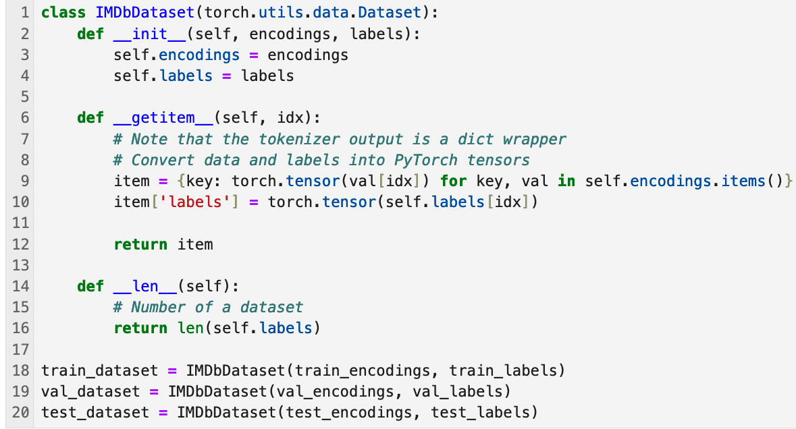
Building the Dataset class using PyTorch
Hugging Face Tutorial

Slide 32
Or you can use Hugging Face Datasets
Using Hugging Face Dataset
# Load the IMDb training set
train = datasets.load_dataset("imdb", split="train")
# Split the validation set
random_seed = 42
splits = train.train_test_split(
test_size=0.2,
seed=random_seed
)
train, valid = splits['train'], splits['test']
# Load the IMDb test set
test = datasets.load_dataset("imdb", split="test")
Hugging Face Tutorial

Slide 33
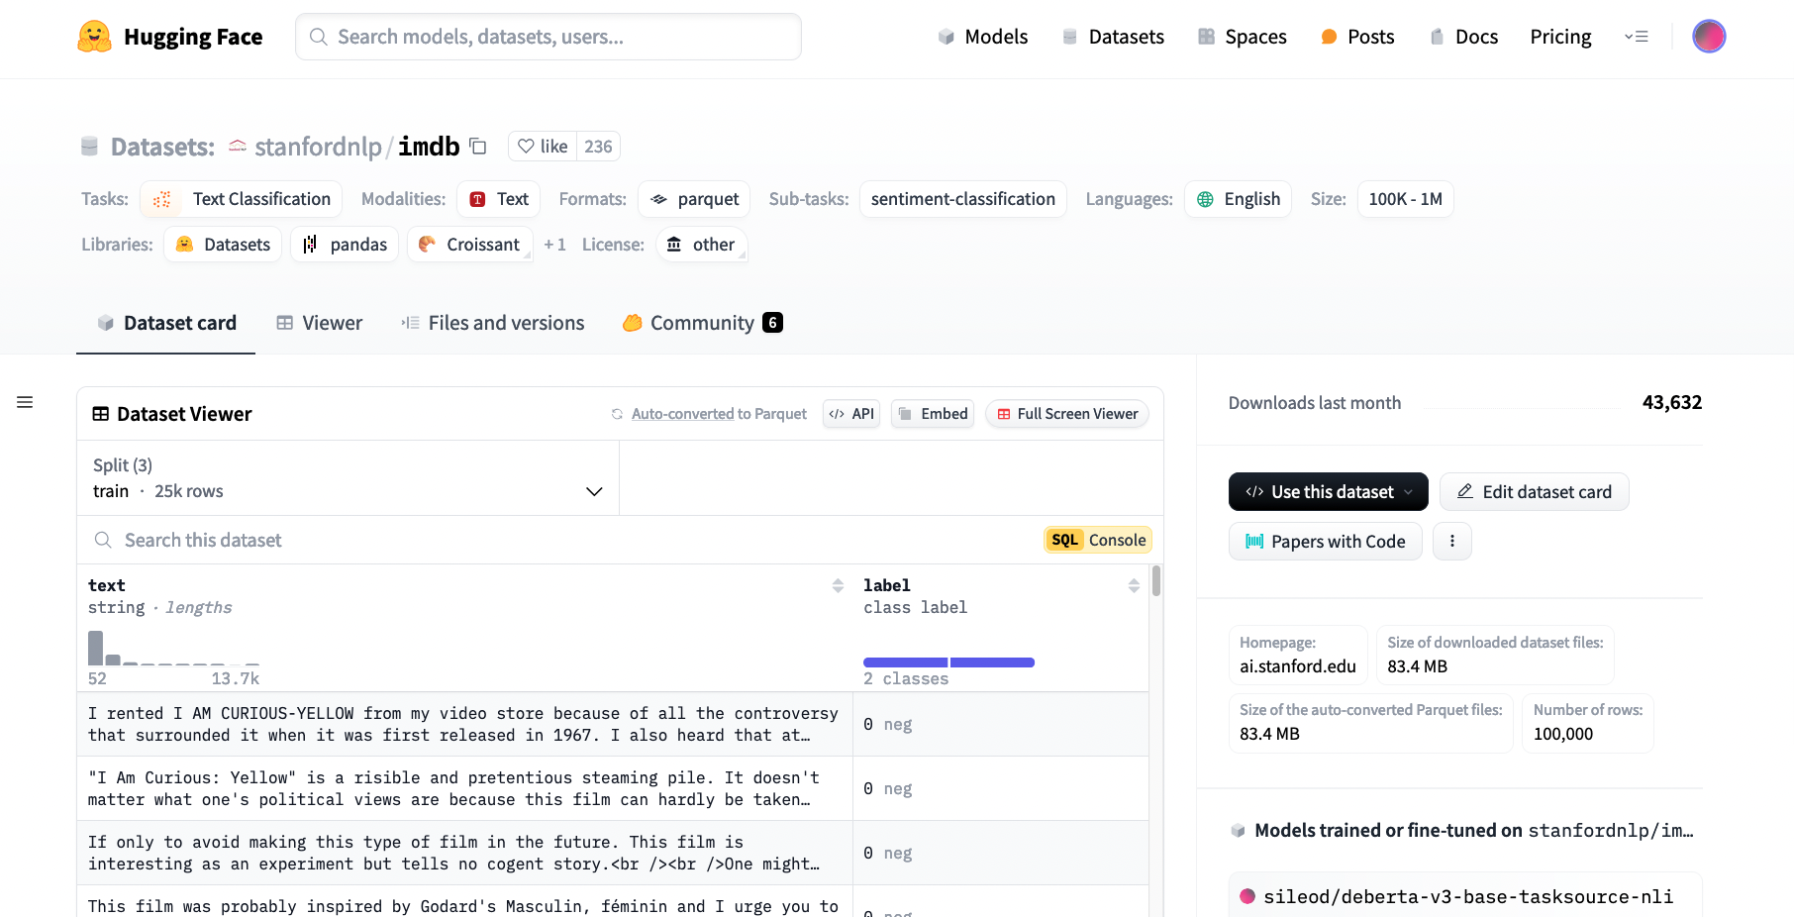
https://huggingface.co/datasets/stanfordnlp/imdb
Hugging Face Tutorial

Slide 34
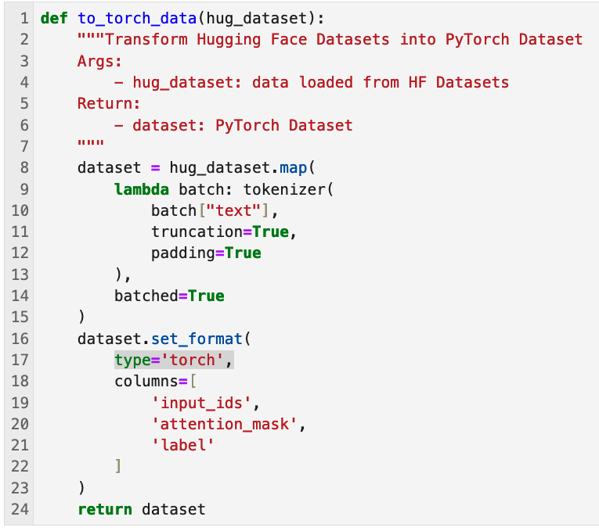
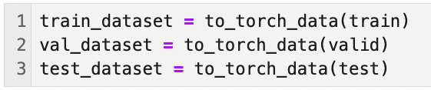
You still need to tokenize the dataset
Using Hugging Face Dataset
Speed up processing (ref)
Set the format of the dataset to return PyTorch tensors instead of lists (ref)
Hugging Face Tutorial

Slide 35
Load the BERT classification model
from transformers import AutoModelForSequenceClassification
model_name = "bert-base-uncased"
# Use .from_pretrained() for a pre-trained model
model = AutoModelForSequenceClassification.from_pretrained(
model_name, num_labels=2
)
我們需要先知道資料集有幾個 classes (num_labels)
Hugging Face Tutorial

Slide 36
Different models for different tasks
Question Answering Tasks (SQuAD v1.1), ref
model = AutoModelForQuestionAnswering.from_pretrained(model_name)
Single Sentence Tagging Tasks (CoNLL-2003 NER; Named Entity Recognition), ref
model = AutoModelForTokenClassification.from_pretrained(model_name)
Semantic Textual Similarity Tasks (STS-B), ref
model = AutoModelForSequenceClassification.from_pretrained(
model_name, num_labels=1
)
Hugging Face Tutorial

Slide 37
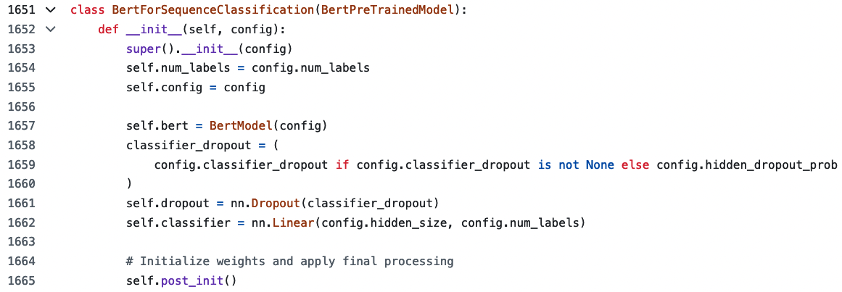
What happens for down-stream tasks?
https://github.com/huggingface/transformers/blob/v4.45.2/src/transformers/models/bert/modeling_bert.py#L1651-L1665
Hugging Face Tutorial

Slide 38
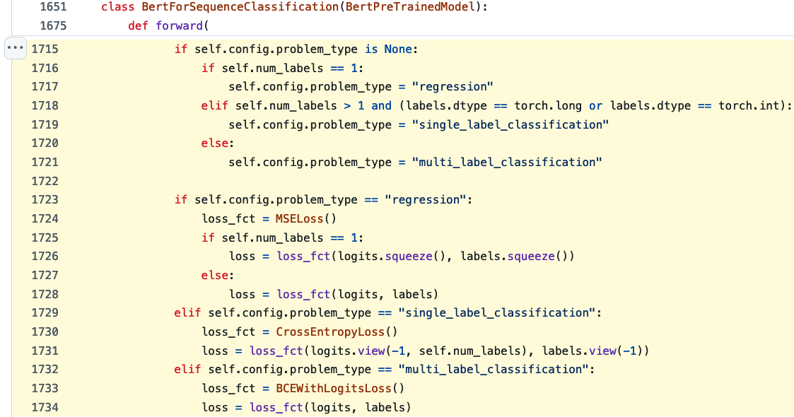
What happens for down-stream tasks?
https://github.com/huggingface/transformers/blob/v4.45.2/src/transformers/models/bert/modeling_bert.py#L1715-L1734
例如 [[1, 0, 1], [1, ,1, 1]]
Hugging Face Tutorial

Slide 39
Model Training with Hugging Face Trainer
Setting up TrainingArguments
Setting up Trainer / metric
trainer.train()
Trainer can perform training, automatic evaluations, and so on.
trainer.predict()
Trainer can also help you perform predictions with a trained model.
Hugging Face Tutorial

Slide 40
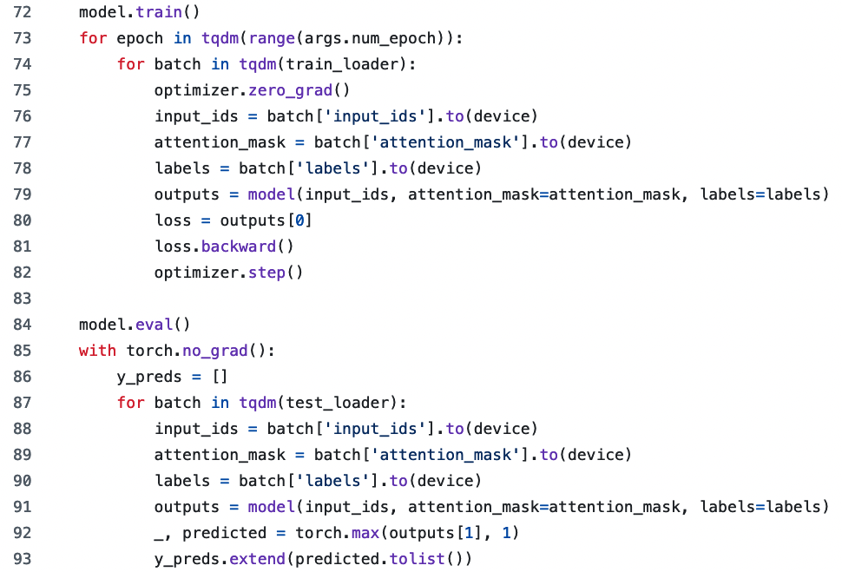
Why Trainer?
This is a training script with native PyTorch (ref).
trainer.train()
Hugging Face Tutorial

Slide 41
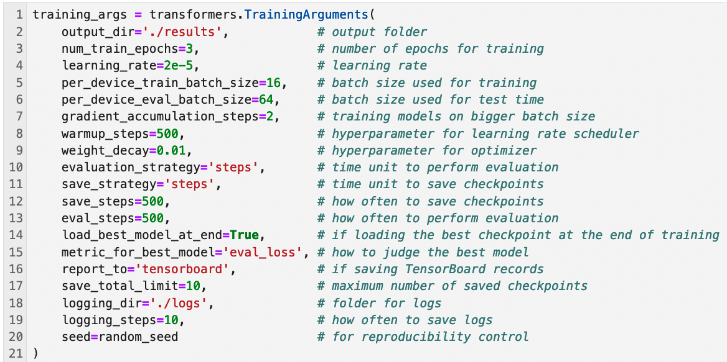
Setting up TrainingArguments
https://huggingface.co/docs/transformers/main_classes/trainer#transformers.TrainingArguments
Hugging Face Tutorial

Slide 42
Learning rate and warmup steps (Linear decay)
LR
LR we set
warm_up steps
Num_steps

Slide 43
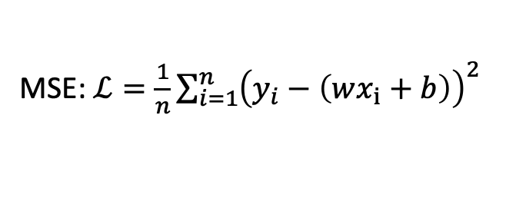
Gradient Accumulation
每個 step 的 loss 計算是基於 batch_size 個 examples
MSE: $ℒ=\frac{1}{n}\sum_{i=1}^{n}{{\left(y_{i}−\left(wx_{i}+b\right)\right)}^{2}}$
(Original) gradient_accumulation_steps=1
Back-propagation
batch
Loss
gradients
(Original) gradient_accumulation_steps=2
batch
Bigger Loss
Back-propagation
(Loss 相加)
gradients
batch

Slide 44
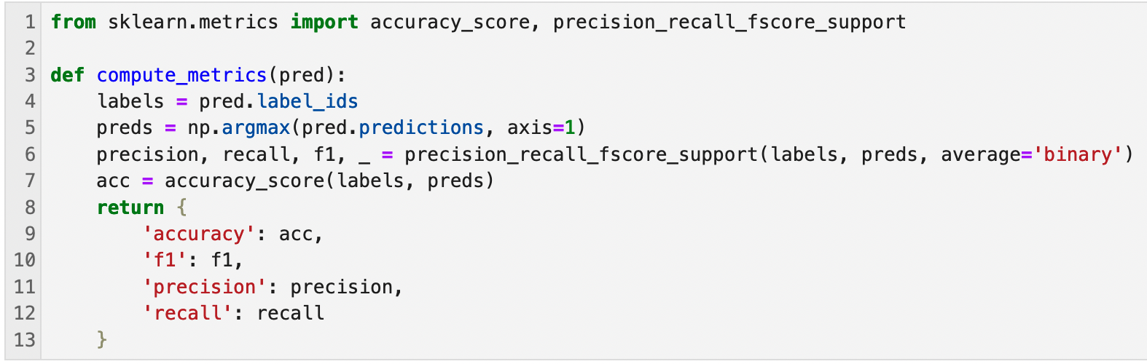
Build a function for evaluations
Hugging Face Tutorial

Slide 45
Setting up Trainer
trainer = transformers.Trainer(
model=model, # 🤗 model
args=training_args, # the `TrainingArguments` you set
train_dataset=train_dataset, # the training dataset
eval_dataset=val_dataset, # the evaluation dataset
compute_metrics=compute_metrics # evaluation metric
)
# Use 1 GPU for training
trainer.args._n_gpu=1
# start training
trainer.train()
https://huggingface.co/docs/transformers/main_classes/trainer#transformers.Trainer
Hugging Face Tutorial

Slide 46
Perform predictions after training
trainer.predict(test_dataset)
This line will call `compute_metrics` using the `test_dataset`.
Because we are now using predict() with trainer, it will not perform model updates.
Hugging Face Tutorial

Slide 47
Thank you!
Instructor: 林英嘉
✉️ yjlin@cgu.edu.tw
TA: 吳宣毅
✉️ m1161007@cgu.edu.tw

